Slide 1
Cryptographic
Attacks
Nishant Harshe, Karun Narayan, Yu Deng, Adrian Wang

Slide 2
Overview
Implement 4 known cryptographic attacks
Differential Attack
Bleichenbacher Attack
FMS(Fluhrer, Mantin and Shamir) Attack
Padding Oracle Attack

Slide 3
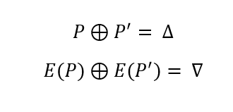
Differential Cryptanalysis
Block Ciphers are non-random, can often leak patterns.
Differentials between inputs often means differential between outputs

Slide 4
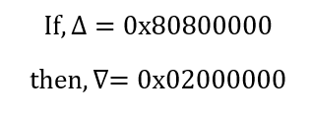
Vulnerability FEAL
There is vulnerability in the FEAL block cipher. In 100% of cases.
This property can be devastating for any cipher that uses the FEAL blockcipher because it can be devastating if the attacker performs the chosen plaintext attack.

Slide 5
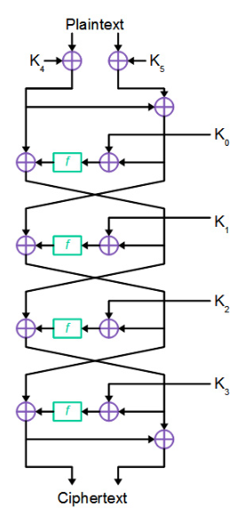
Exploit on FEAL-4
FEAL-4 is an encryption algorithm that uses the FEAL blockcipher in a Feistel Network as shown to the right.
This makes it a little harder to break than just the blockcipher alone, because it uses it in 4 rounds.

Slide 6
Our Attack
To use the differential property that we know about the FEAL blockcipher to break the FEAL-4 cipher i.e. retrieve all the subkeys that are used in the FEAL-4 cipher using a chosen plaintext attack.

Slide 7
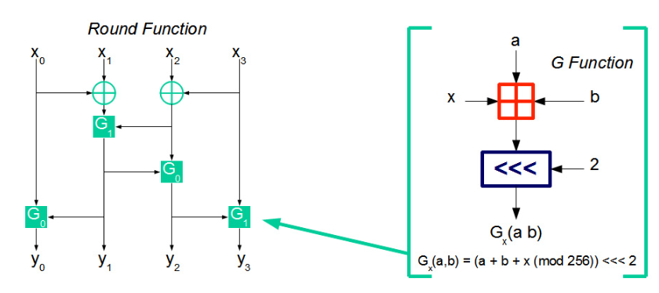
The Rounds
Each round of the blockcipher splits the input into 4 parts and uses the addition and bit shift function to modify the bits.
We use the to predict the subkeys during our attack.

Slide 8
To start the attack
We can predict with 100% guarantee what the output of the first 3 rounds will be using the differential property that we know. We find random plaintexts whose differential is 0x8080000080800000 and find their cipher tests.

Slide 9
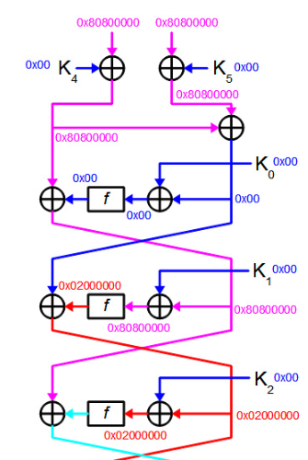
After the first 3 rounds
Here are the differential predictions of the after the first 3 rounds of FEAL-4 if the keys were all 0x00. After this we cannot predict the behavior of the ciphers because the differentials between the inputs are not predictable.
We now have to work in reverse to reach the middle.

Slide 10
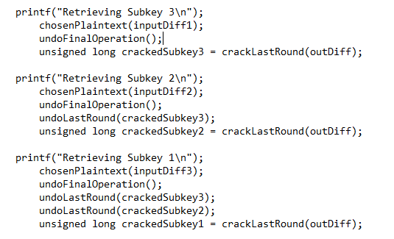
Retrieving subkeys
Since we know the behavior of the first few rounds we generate our plaintexts pair such that we can use see which ones give use the correct output differential of 0x2000000 and determine the subkeys for the 3 rounds.

Slide 11
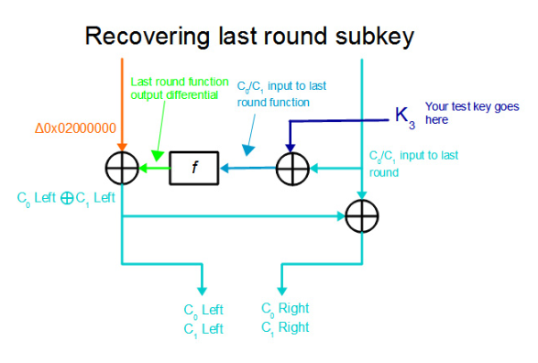
Cracking the Final Stage
To crack the final stage we have to use several trials of the third subkey to see which ones generate the correct cipher texts.
Luckily since it is only done for each round individually it’s quite feasible.
(2³² combinations)

Slide 12
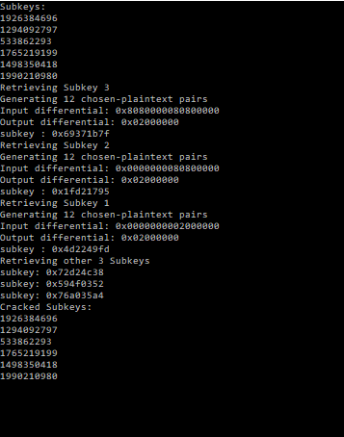
Results
Using the method described we have a high probability of retrieving the subkeys and cracking the FEAL-4 cipher. This algorithm does tend to take quite a while to run but should almost always be successful.

Slide 13
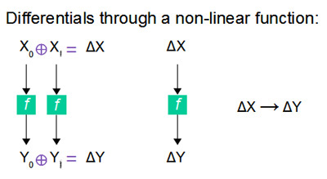

Slide 14
Bleichenbacher Vulnerability
Occurs during RSA encryption when using PKCS#1 v1.5 padding.
A server decrypting the message returns a notification saying if the decryption was successful.

Slide 15
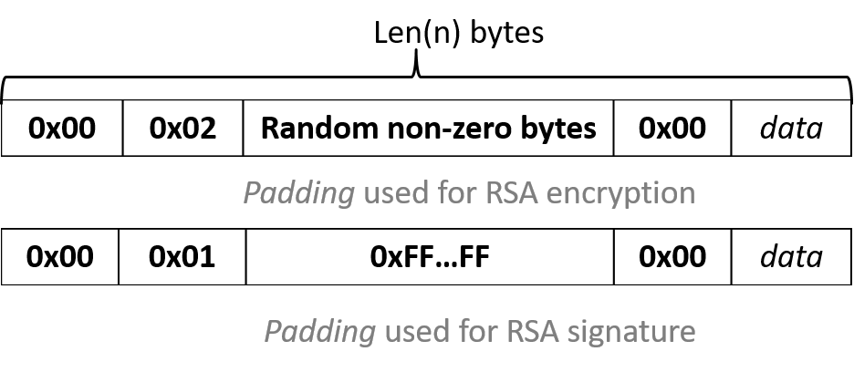
Padding Vulnerability
The first two bytes are always constant as well as the zero byte after random padding
This padding is useful information to the attacker, gives them the correct organization of a message

Slide 16
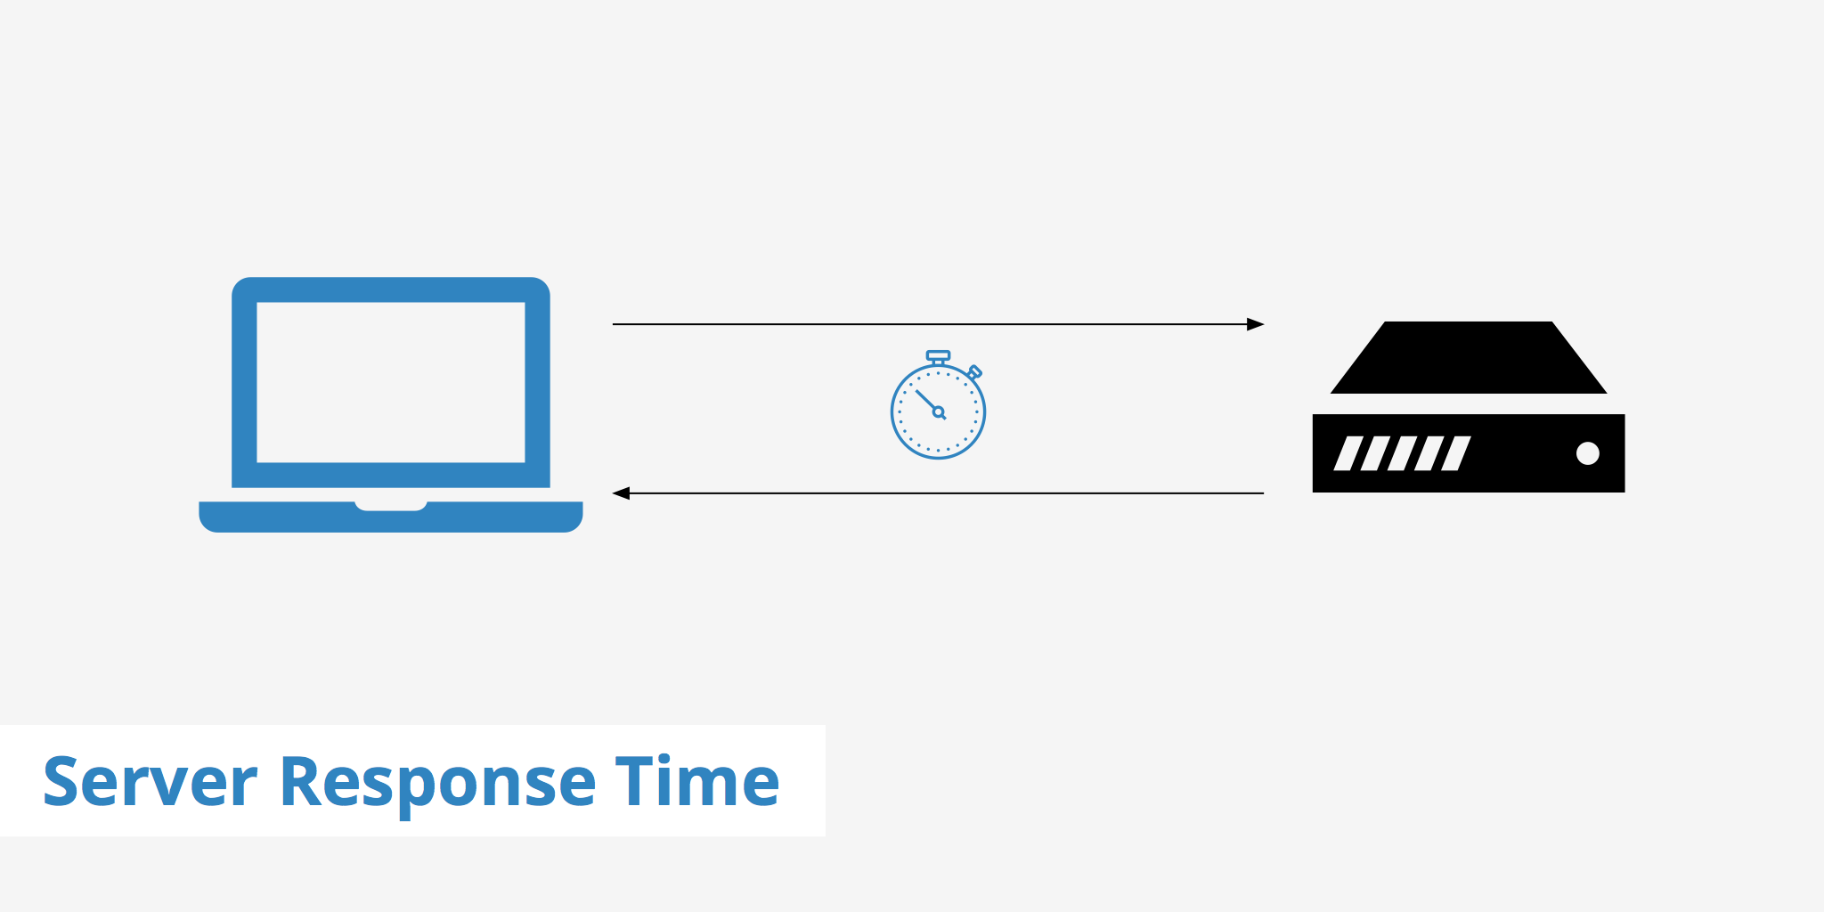
Server Vulnerability
The server sends back messages that notify user if message he sent was successful
This is then used by an attacker to directly verify whether or not his custom message was read successfully

Slide 17
Steps for Exploit
You combine the two vulnerabilities to create the exploit.
First you hijack a a connection between a user and server
Then you take the users encrypted cypher message and multiply a ‘S’ value to the the cipher
Send to the server which acts as the PADDING ORACLE and wait for a response
If response is successful you can use that s value to crack other messages
Else repeat with a different ‘S’ value

Slide 18
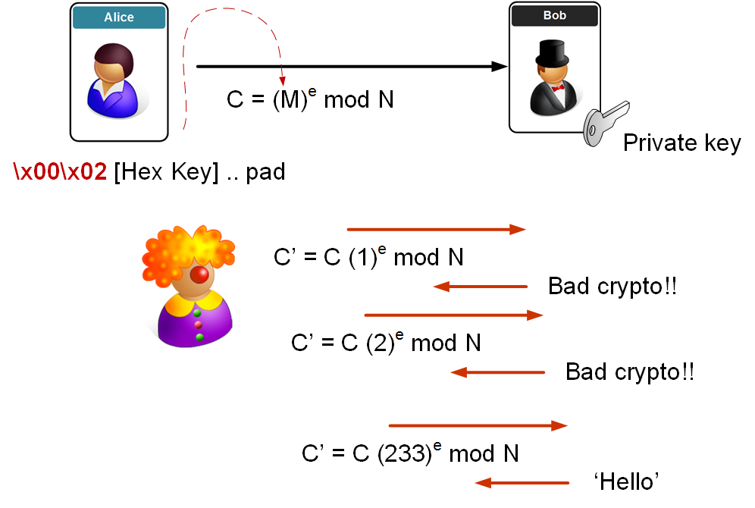
Bleichenbacher Exploit

Slide 19
Implementation

Slide 20
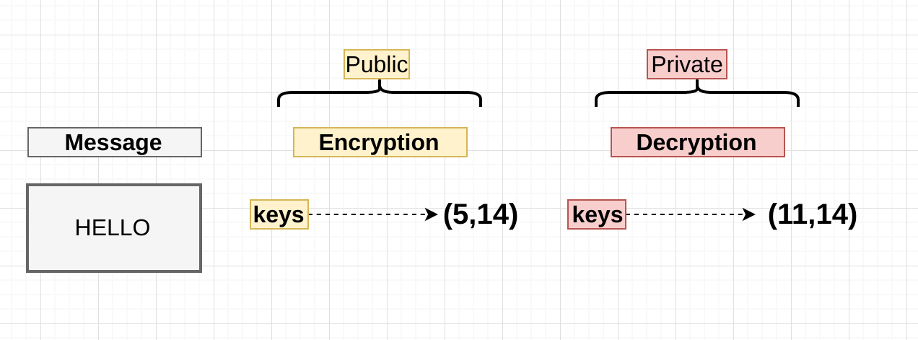
First Step
Here we create custom RSA keys using
Public key encrypts data then private key decrypts
The user encrypts and creates a cipher message which is sent to server

Slide 21
Second Step
Next you would hijack the connection and intercept the message
The message is then multiplied with ‘S’ which is used to help you crack the private key.
C’ = C *(S)^e MOD N
Here we grabbed C from the User, e is the public exponent and N is public modulus
We test different S values that crack the decryption

Slide 22
Third Step
Server receives the cipher and attempts to decrypt
M’ = (CxS^e)^d Mod N
Here d is the private key
This equation decrypts on the server side.
If the decryption is successful then the attacker is notified
Then the attacker knows the S value is useful

Slide 23
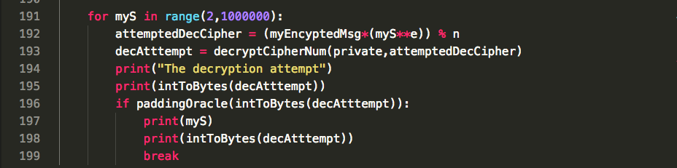
Fourth Step
If the message was unsuccessful, Repeatedly send the message with a different value of S and wait for a potential matched decryption

Slide 24
Challenges
When creating custom RSA keys they use incredibly large numbers making it hard to work with
Created my own generation of RSA keys that make various computations easier
I modified the size of the message to make execution more convenient
Changed the total message to 10 bytes to
Originally the padding oracle looks at the first byte and second byte
The first byte is 0 but when accessing the byte through code since its the most significant bit, it gets ignored
So i looked at the byte with value 2 and the 0 byte after random values

Slide 25
Prevention Of Attack
A good prevention is to have a server that does not return messages back to the User
The attacker would not have a verification system to see if his Custom messages are successfully being decrypted or not
Another prevention is in the padding itself
Hashing is used to create redundancy with the encrypted message to make the deciphering the padding much more difficult
Another prevention is to not use PKCS#1 v1.5 padding.

Slide 26
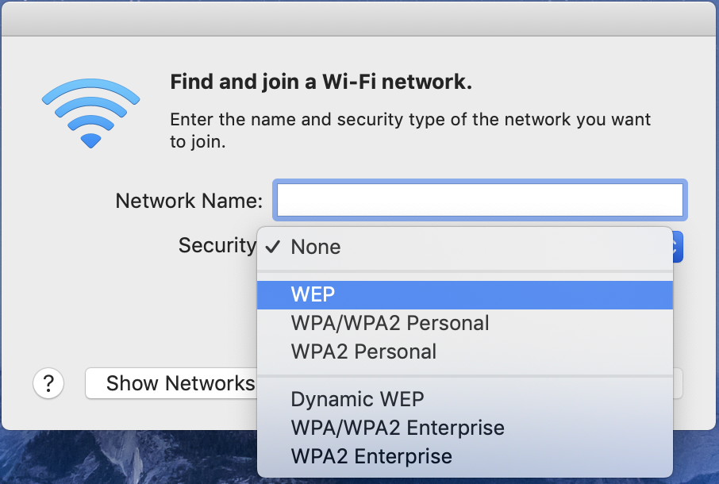
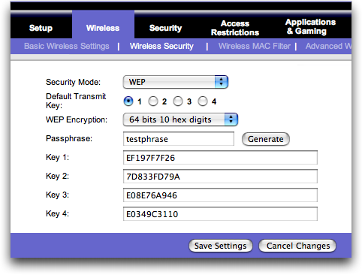
FMS Attack
Based on WEP, which uses RC4 for confidentiality.
Picture: https://arstechnica.com/information-technology/2008/11/wpa-cracked/

Slide 27
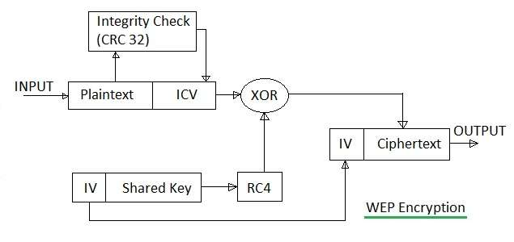
WEP
WEP was included as the privacy component of the original IEEE 802.11 standard ratified in 1997.
It uses RC4 for confidentiality and CRC-32 checksum for integrity.
Picture: http://www.rfwireless-world.com/Terminology/WEP-vs-WPA-vs-WPA2.html

Slide 28
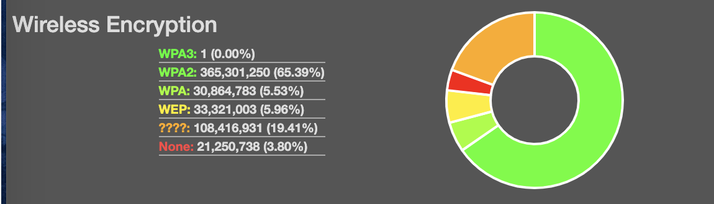
WEP Deprecated
It was superseded by WPA, announced by WIFI Alliance in 2003.
It was declared deprecated by IEEE in 2004.
According to https://wigle.net/stats#, 5.96% wireless network still uses WEP for its encryption today (June 2019), because there are some legacy devices that could only operate in some certain environment.

Slide 29
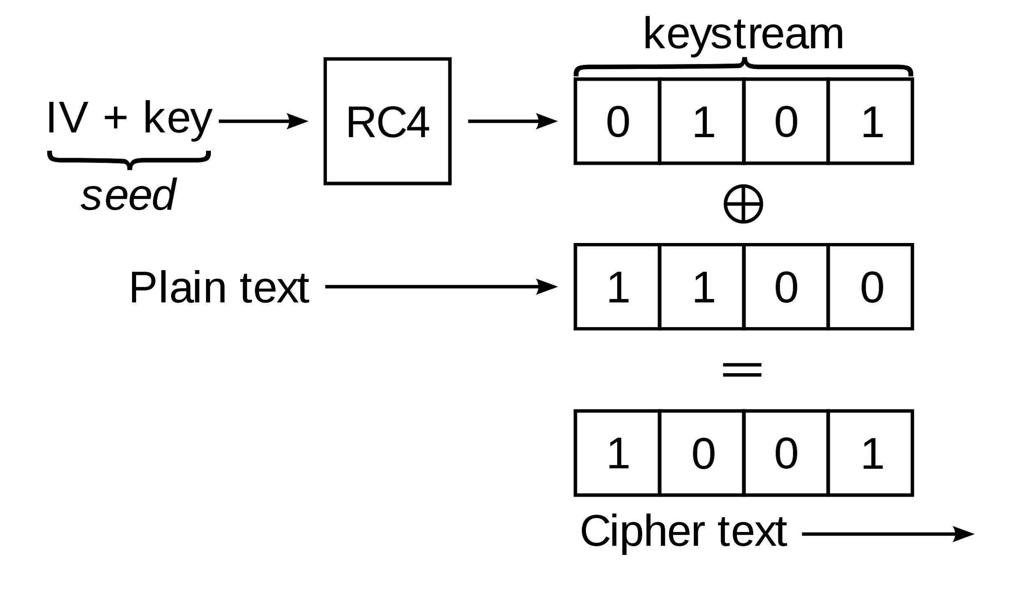
RC4 Algorithm - Overview
RC4 is a stream cipher, which works like a one time padding.
If Pseudo-Random Generator cannot guarantee randomness, key will be recovered.
First, let’s see how RC4 works in detail.
Picture: https://en.wikipedia.org/wiki/Wired_Equivalent_Privacy

Slide 30
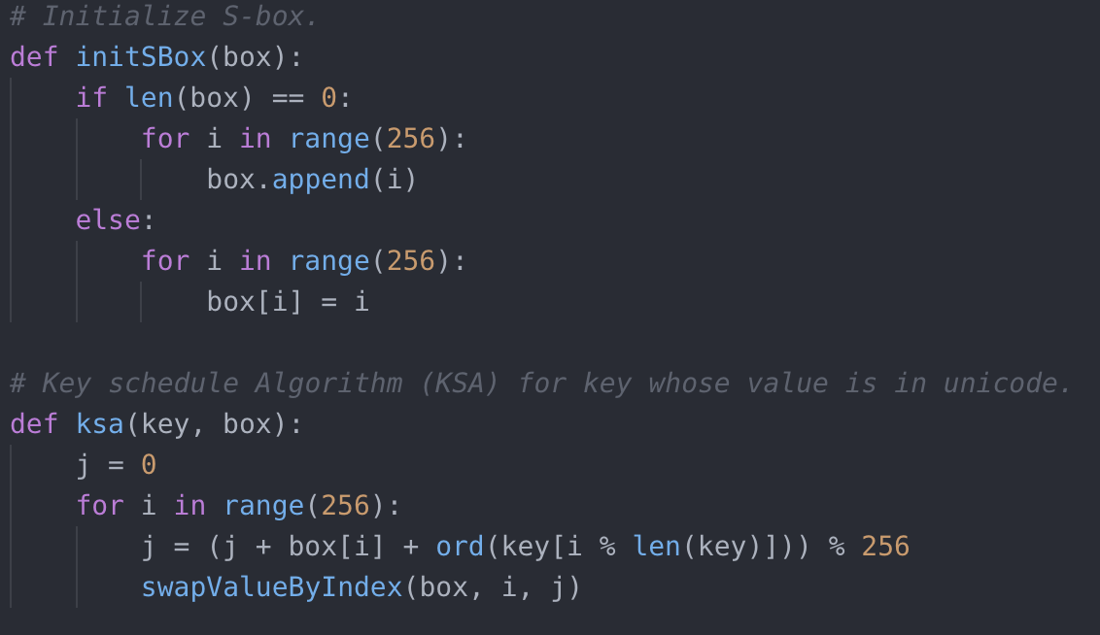
RC4 Algorithm - KSA (Key Schedule Algorithm)
S-Box (substitution box) is a component widely used in symmetric key algorithm. User input a value and a seemingly irrelevant value is output.
I implemented it as an array with length 256 (permutation of all possible 1 byte).

Slide 31
RC4 Algorithm - KSA (Key Schedule Algorithm)
The value of S-Box is disrupted in each loop by the user input key. There will always two index’s values be swapped. This makes it very difficult to recover its original status.

Slide 32
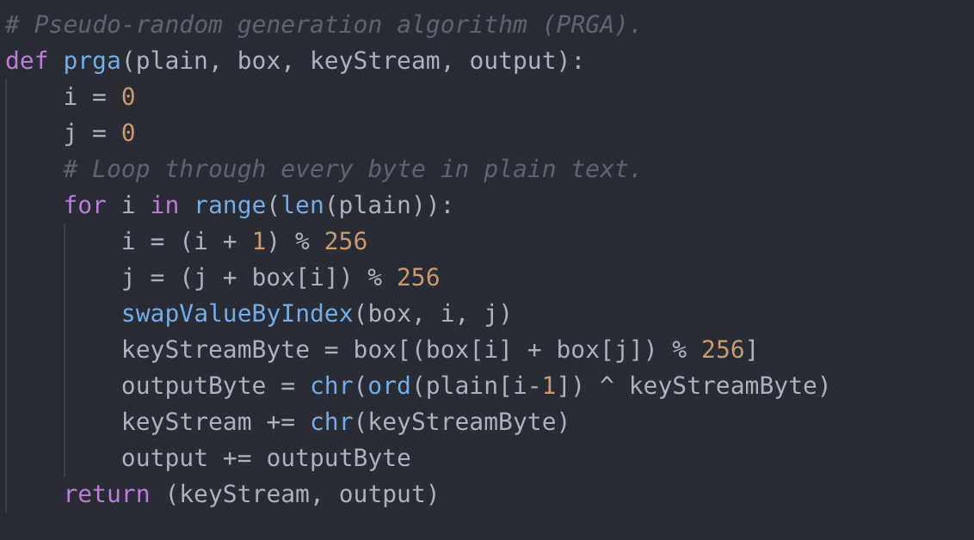
RC4 Algorithm - PRGA ( Pseudo Random Generation Algorithm)
When generating the pseudo random key stream, two indexes’ value will also be swapped, making each state different and hard to track its original state.

Slide 33

RC4 Weakness
As a stream cipher, it is dangerous to use the same key over and over again, because the same key stream will be generated if the key is the same.
So, in WEP, apart from user input’s key, an initialization vector is prepended to it, making each stream cipher different from others.
But, there are still weakness.

Slide 34
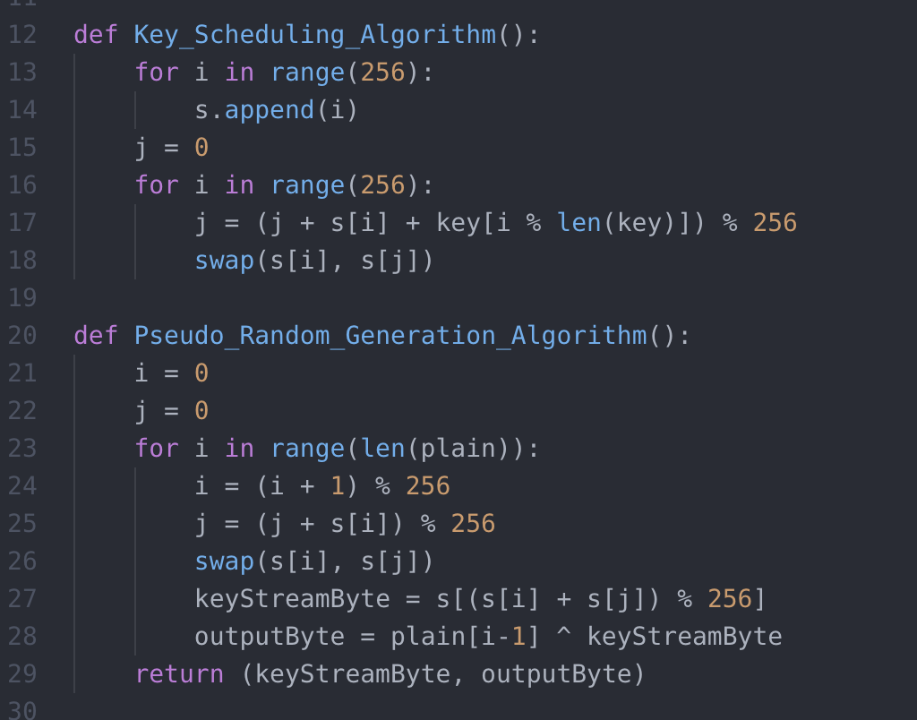
RC4 Weakness
RC4 uses a constantly-changing S-Box to ensure randomness.
In the attack, FMS defined a Resolved Condition:
i = 1
j = s[1],
Y = s[ j + s[j] ] =
keyStreamByte[0] = s[s[1] + s[ j ]] ,
will not be disturbed in future swap.
Probability greater than e⁻³≈ 0.05.
Notes:
Originally, RC4 uses a constantly-changing S-Box to ensure randomness. Resolved condition -> certain bytes will not be disturbed in future swap. If we can have the final status of S-Box, we know the initialized status, which depends only on the user-provided key. Final status is leaked in WEP, and thus we can recover the original key. In real world, WEP protocol is not recommended to use and RC4 is prohibited using in TLS.

Slide 35
Recover the key in WEP
First, let’s define that after iterated over t times, the S-Box is at state S_{t} , the index are i_{t} and j_{t} , the current output key stream byte is Z_{t} . Then we have:
z_{t} = S_{t}[S_{t}[ i_{t} ] + S_{t}[ j_{t} ] ]
We define L to be length of session key, and I be length of IV (In our case I = 3). Then we have key:
K = [IV[0], IV[1], IV[2], SK[0], SK[1],....SK[l - 1 - i]] (SK is user-entered secret key)
We attempt to recover the key starting from the first unknown secret key index A, this index locates at (A+3) in key.
As eavesdropper, we know the IV, encrypted cipher stream, and first byte of plain text ‘aa’, which is SNAP header used in WEP.

Slide 36
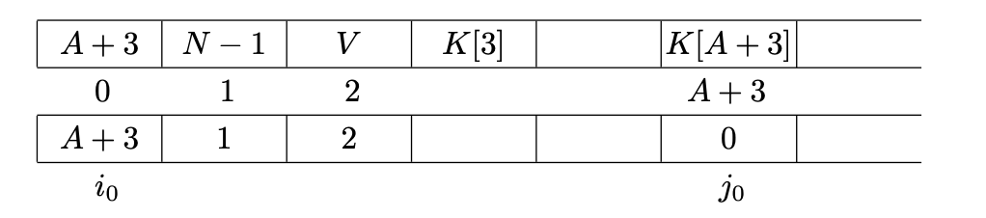
Recover the key in WEP
We want to examine the IV with a form of (A+3, N-1=255, V). V could be any number. We can see the reason why such form below:
In first round of ksa, the S-Box status is:

Slide 37
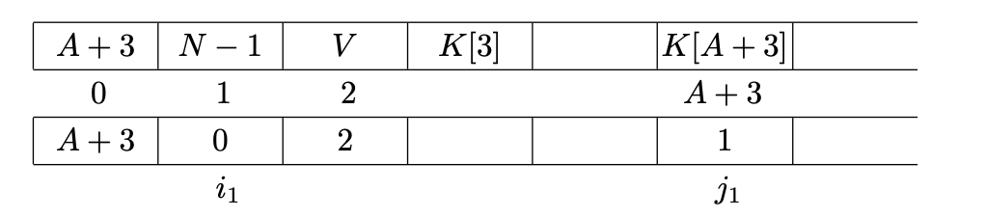
Recover the key in WEP
In the second round of ksa, the S-Box status is:
Then, in the next round, j will be changed by adding V + 2.
All the rounds later can be calculated by attacker until he encountered the first byte he doesn’t know (A+3). At this point, he can drop this IV trial by checking if S[0] and S[1] has changed.

Slide 38
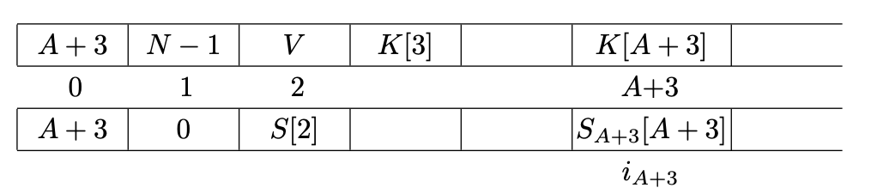
Recover the key in WEP
If it has not changed, then the attacker knows that j will be added by
S_{A+2}[i_{A+3}] + K[A + 3], and then perform the swap. The S-Box status would be:
Because the attacker knows S_{A+2} and j_{A+2}, If the attacker knows the value of
S_{A+3}[A + 3], he knows its location in S_{A+2}, which is the value of j_{A+3}, and hence he would be able to compute K[A + 3].

Slide 39
Recover the key in WEP
The formula is:
z0 = S[S[1] + S[S[1]]]
= S[0 + S[0]]
= S[A + 3]
= S_{A}+2[j_{A+3}]
= S_{A}+2[j_{A+2} + S_{A+2}[A + 3] + K[A + 3]]

Slide 40
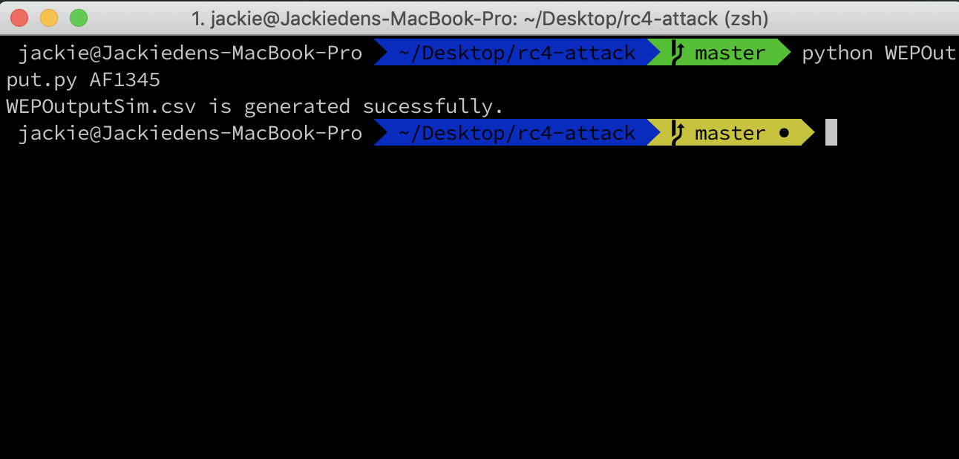
Demo of FMS Attack - Generate simulated WEP Packets
In the terminal, we run WEPOutput.py with user input key, for example, ‘AF1423’
to create WEPOutputSim.csv files, which stores each possible IV in our desired form:
(A+3, 255, V).
And we also store the first key stream byte. We assume that these info is available to the attacker.

Slide 41
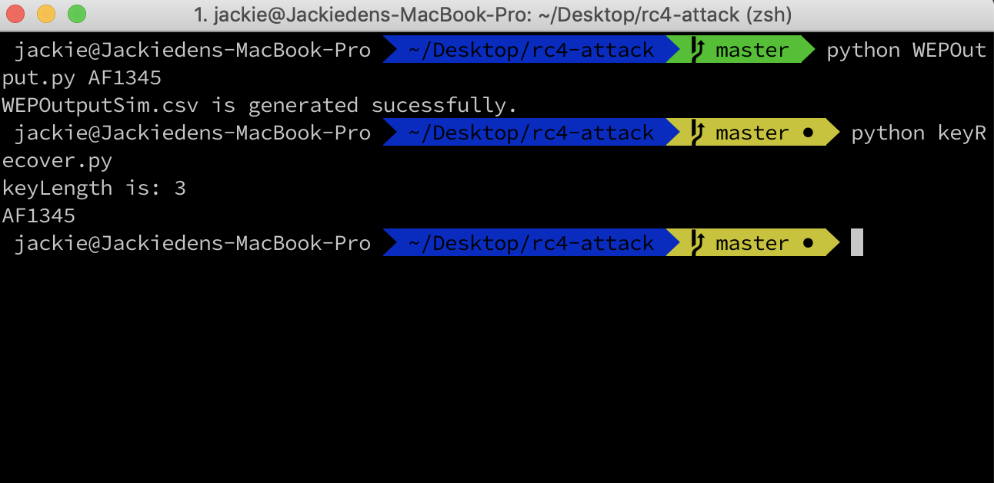
Demo of FMS Attack - Recover the key based on Packets
Then, we run keyRecover.py (this program utilizes WEPOutputSim.csv):
It will run based on FMS Attack, and output the highest possible key. In our case, it matches the original entered key.

Slide 42
FMS Attack - Summary
In WEP, the IV is always prepended to the user input key. Since user input key is most likely remains the same for a same network, the attacker is able to eavesdrop a lot of packets and based on the known IV and SNAP header, the secret key can be recovered.
Thus, don’t use WEP encryption anymore!
Please note that some graphs I use in this presentation are from FMS Attack source paper:
Fluhrer, S., Mantin, I., and A. Shamir, "Weaknesses in the Key Scheduling Algorithm of RC4", Selected Areas of Cryptography: SAC 2001, Lecture Notes in Computer Science Vol. 2259, pp 1-24, 2001.

Slide 43
AES-CBC Padding Vulnerability

Slide 44
Overview of AES-CBC-* Ciphersuites in TLS
Encryption
Plaintext = Message || MAC(Message) || Padding
Ciphertext = Encrypt(Plaintext)
Send(Header || Ciphertext)
Decryption
Ciphertext = StripHeader(Ciphertext)
Plaintext = Decrypt(Ciphertext)
Message || MAC = Unpad(Plaintext)
MAC-Verify(Message, MAC)
If ok, Message valid, else return invalid

Slide 45
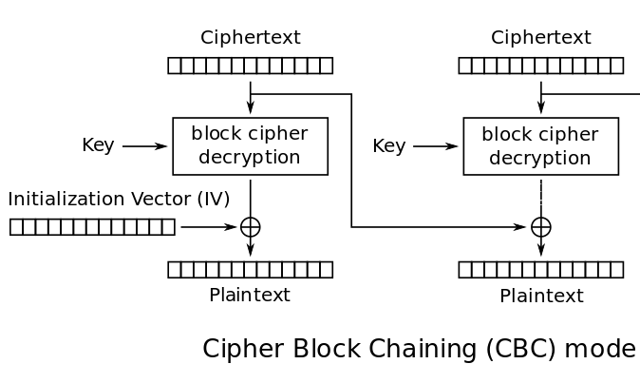
Key Component: CBC mode
CBC mode relates ciphertext blocks meaningfully to each other
By itself not a vulnerability
Ciphertext relationships exploited via another vulnerability
Notes:
For my topic, I investigated the padding oracle vulnerability in AES-CBC mode encryption schemes, which exist in ciphersuites used by TLS. The vulnerability exists in the fact that plaintexts must be padded to an even multiple of the block size, in conjunction with the fact that the vulnerable AE schemes use MAC-then-Encrypt as their method for authenticated encryption. Specifically, in order to determine which MAC to calculate, the receiver must first figure out where the MAC is, then remove the padding. This can be exploited to give away information about the plaintext.

Slide 46
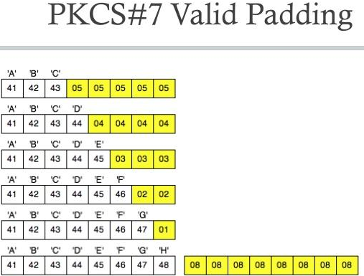
Key Component: Padding
Padding is composed of enough bytes to make plaintext a multiple of cipher block size
Gives structure to the last block of plaintext
Narrows down possible contents in last block
For AES-CBC, block size = 16, so could be 0x01, …, 0x10

Slide 47
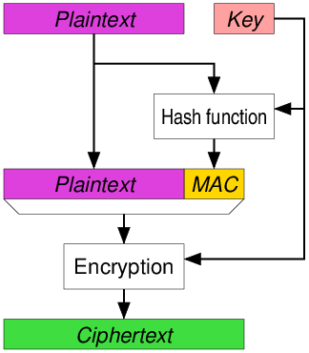
Weakness of MAC-then-Encrypt
TLS protocol generates MAC of plaintext then encrypts everything
Does not provide ciphertext integrity because need to decrypt to check authenticity
Possible to alter ciphertext and have recipient attempt to decrypt

Slide 48
Key Vulnerability
Valid oracle responds true if ciphertext has valid padding i.e. Step 3 completed successfully
Valid Oracle can be realized by invalid padding error messages, or by timing MAC verification time
Assume that we have the valid oracle
Valid(x)

Slide 49
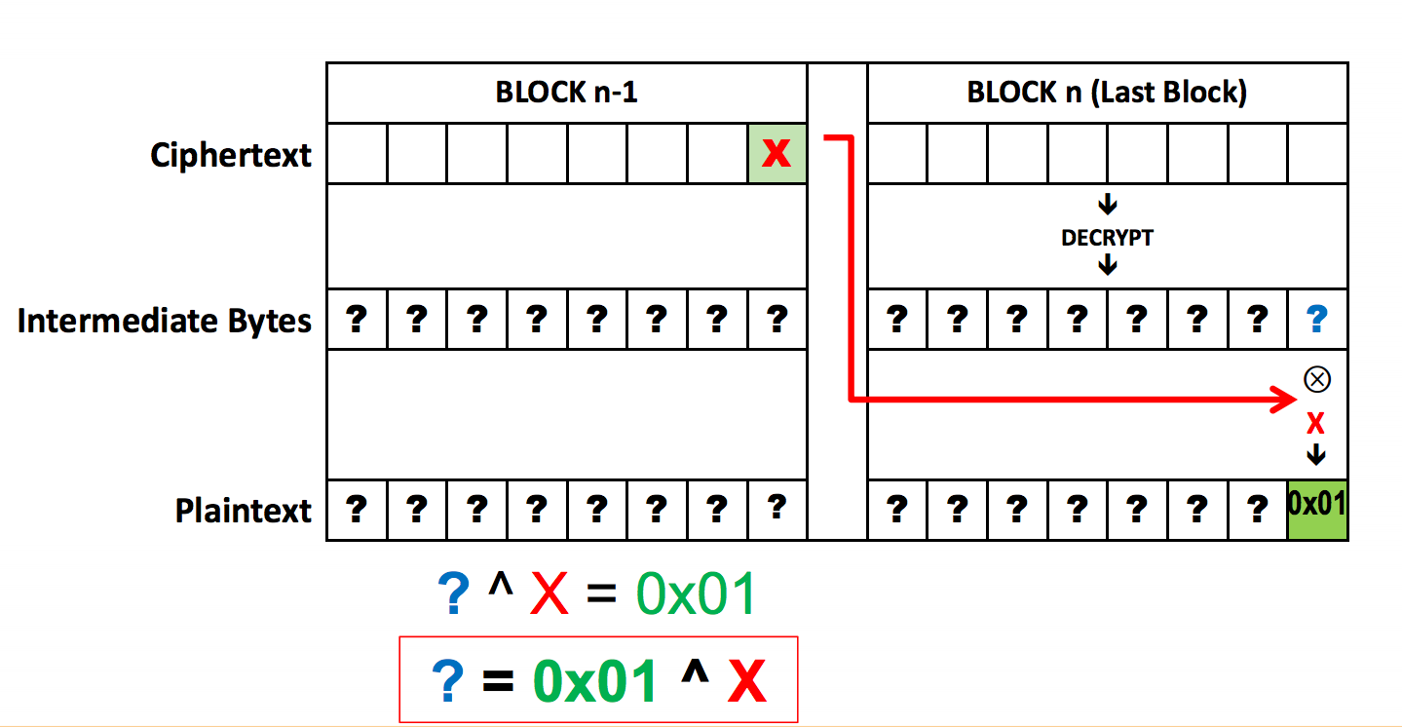
Padding Oracle Attack
Last ciphertext block relationship with previous ciphertext block is P_{i} = D(C_{i}) ⊕ C_{i-1}
Apply a byte-mask Δ to previous ciphertext block to alter last plaintext block by XOR: P’_{i}= D(C_{i}) ⊕ (C_{i-1}⊕ Δ) = P_{i} ⊕ Δ
Start from last byte and iterate through all possible byte values (0-255) in the mask to produce altered ciphertext C’_{i} and check Valid(C’_{i})
If it returns true we have the case of a plaintext ending with 0x01, 0x02, …, 0x08
Find which corresponds to 0x01 by changing previous byte to any value, then consult Valid again. If true then the plaintext ended with 0x01 since it was a valid pad.
Since 0x01 = P_{i} ⊕ Δ, 0x01 ⊕ Δ = P_{i}
Notes:
In order to use this construction to our advantage, we need an oracle that tells us whether a plaintext’s padding was valid or not. Let’s call this the valid oracle. Using the valid oracle, the property of block ciphers, and the fact that plaintexts must end with padding, we can recover the entire plaintext without knowing the key. Using this method, we can decode a ciphertext in O(N*B*2^8) where N is the number of blocks and B is the block size. This is significantly faster than a brute force attack.

Slide 50
Recovering Remaining Plaintext Bytes
Since the mask that makes the last byte 0x01 is already known, we can easily set the last byte to 0x02. Recall P_{i} ⊕ Δ = 0x01, then 0x02 = P_{i} ⊕ Δ ⊕ 0x01 ⊕ 0x02
We can then search the second to last byte of the mask to find the mask that makes the plaintext end with 0x02 || 0x02, which allows us to recover the second to last plaintext byte by the same method as before: 0x02 ⊕ Δ = P_{i}
This can be done for all the bytes in the block

Slide 51
Recovering All Blocks
Recovering a block only requires the corresponding ciphertext block and the ciphertext block before it
After recovering one block, remove that block, then repeat on the now last two blocks
Runtime is O(N*B*2^8) for blocksize B and num blocks N

Slide 52
Other Considerations
In reality, TLS protocol disallows meaning error messages.
When padding fails, TLS specifies to run MAC verify assuming no padding bytes
Valid Oracle usually derived from time difference in doing MAC verification between an incorrectly padded message and a correctly padded message i.e. timing side channel attack

Slide 53
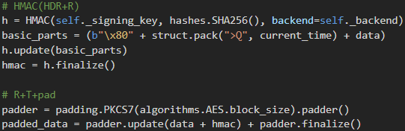
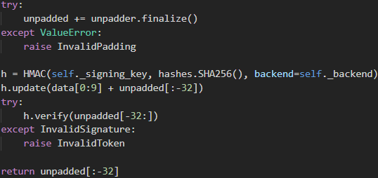
Padding Oracle Demo
Structure of Plaintext
Padding Oracle →

Slide 54
Further Reading & Reference
Wagner D. (1999) The Boomerang Attack. In: Knudsen L. (eds) Fast Software Encryption. FSE 1999. Lecture Notes in Computer Science, vol 1636. Springer, Berlin, Heidelberg
King, Jon. “Differential Cryptanalysis of FEAL.” Differential Cryptanalysis of FEAL, 12 May 2013,
Bleichenbacher, Daniel. “Chosen Ciphertext Attacks Against Protocols Based on the RSA Encryption Standard PKCS #1.” Archiv.infsec.ethz.ch, 2006, archiv.infsec.ethz.ch/education/fs08/secsem/bleichenbacher98.pdf.
Buchanan, Bill. “Bleichenbacher's Attack.” Bleichenbacher's Attack, asecuritysite.com/encryption/c_c3.
Fluhrer, S., Mantin, I., and A. Shamir, "Weaknesses in the Key Scheduling Algorithm of RC4", Selected Areas of Cryptography: SAC 2001, Lecture Notes in Computer Science Vol. 2259, pp 1-24, 2001.
Vaudenay, Serge. "Security Flaws Induced by CBC Padding—Applications to SSL, IPSEC, WTLS..." International Conference on the Theory and Applications of Cryptographic Techniques. Springer, Berlin, Heidelberg, 2002.
Al Fardan, Nadhem J., and Kenneth G. Paterson. "Lucky thirteen: Breaking the TLS and DTLS record protocols." 2013 IEEE Symposium on Security and Privacy. IEEE, 2013.
Our Git Repo: https://github.com/atwang9503/LuckyThirteenAttack

